Slide 1
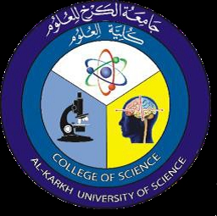
Antibiotics and chemotherapeutic agents
2nd Year – 1st semester
Dr. Munira Ch. Ismail

Slide 2
What is the definition of antibiotics?
Antibiotics are medicines that treat infections by killing bacteria. They don't work on viruses, like the flu.
Examples of antibiotics:
– Penicillin and Ciprofloxacin

Slide 3
Spectrum of Antibiotic
Spectrum of activity: Each antibacterial drug has a range of microorganisms that it affects. According for this reason antibiotics can be divided into :
Broad spectrum: Active against many different types of bacteria
Narrow spectrum: Active against one or a few types of bacteria

Slide 4
Antibiotics:Chemical substanceproducedby microorganisms that inhibits the growth or kills other microorganisms.
Antimicrobiaagents:Chemicalsubstances from abiological source or produced by chemical synthesis that kills orinhibits the growth of microorganisms .

Slide 5
History of Antibiotics:
History of antibiotics can be described in two segments as under:
1-Early History:
During ancient times;
Greeks and Indians used moulds and other plants to treat infections.
In Greece and Serbia, mouldy bread was traditionally used to treat wounds and infections.
Warm soil was used in Russia by peasants to cure infected wounds.
Sumerian doctors gave patients beer soup mixed with turtle shells and snake skins.
Babylonian doctors healed the eyes using a mixture of frog bile and sour milk.
Sri Lankan army used oil cake (sweetmeat) to server both as desiccant and antibacterial

Slide 6
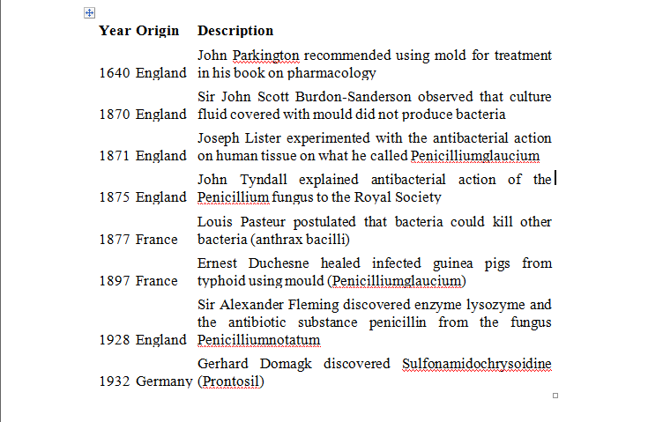
2-MODERN HISTORY:

Slide 7
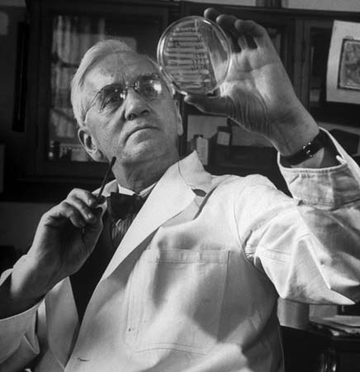
Sir Alexander Fleming
a Scottish biologist, defined new horizons for modern antibiotics with his discoveries of enzyme lysozyme (1921) and the antibiotic substance penicillin (1928). The discovery of penicillin from the fungus Penicilliumnotatum perfected the treatment of bacterial infections such as, syphilis, gangrene and tuberculosis. He also contributed immensely towards medical sciences with his writings on the subjects of bacteriology,
immunology,
and chemotherapy.

Slide 8
How Do Antibiotics Work?
Various types of antibiotics work in either of the following two ways:
A Bactericidal antibiotic kills the bacteria generally by either interfering with the formation of the bacterium's cell wall or its cell contents.
Penicillin, daptomycin, fluoroquinolones, metronidazole, nitrofurantoin and co-trimoxazole are some example of Bactericidal antibiotics.
A Bacteriostatic antibiotic stops bacteria from multiplying by interfering with bacterial protein production, DNA replication, or other aspects of bacterial cellular metabolism.
Some Bacteriostatic antibiotics are tetracyclines, sulphonamides, spectinomycin, trimethoprim, chloramphenicol, macrolides and lincosamides.

Slide 9
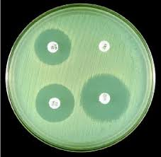
Antimicrobial medicines can be grouped according to the microorganisms they act primarily against them. For example, antibacterials( antibiotics) are used against bacteria and antifungals are used against fungi and antiviral drugs against viruses.
The use of antimicrobial medicines to treat infection is known as antimicrobial chemotherapy, while the use of antimicrobial medicines to prevent infection is known asantimicrobial prophylaxis.
Antibacterial activity

Slide 10
The main classes of antimicrobial agents are:
Disinfectants ("nonselective antimicrobials" such as bleach), which kill a wide range of microbes on non-living surfaces to prevent the spread of illness.
Antiseptics(which are applied to living tissue and help reduce infection during surgery) such as ethyl alcohol at 95% or isopropanol.
Antibiotics (which destroy microorganisms within the body).
The ideal antibacterial agent should he nontoxic to the host (selective toxicity),non-allergenic, soluble in body fluids, able to be maintained at therapeutic levels, have a low probability of eliciting resistance, long shelf life, and low cost.
Chemotherapeutic agent (drug):Any chemical agent (natural or synthetic) that is used inmedicine. Ideally, it should attack microorganisms selectively and not harm host cells.

Slide 11
Sources of antibiotics:
a. Natural drug-one made by microorganisms.
b. Synthetic drugs that is made in the laboratory.
c. Semisynthetic drug-one synthesized partly in the laboratory and partly by microorganisms.

Slide 12
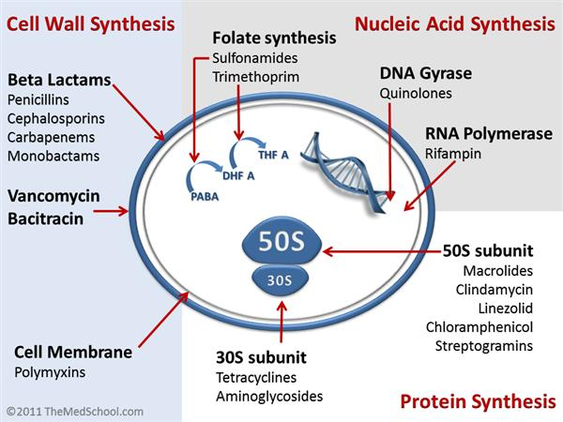
Mechanisms of action of antibiotics :

Slide 13
Microbes are killed through various means:
1-Inhibition of the cell wall:
Specific antibacterials interfere with the synthesis of the cell wall, weakening the peptidoglycan scaffold within the bacterial wall so that the structural integrity eventually fails. For example : penicillin's and cephalosporinsare β – lactam drugsact by inhibiting transpeptidases, the enzymes that catalyze the final cross – linking step in the synthesis of peptidoglycan .

Slide 14
2-Inhibition of protein synthesis:
Several drugs inhibit protein synthesis in bacteria without significantly interfering with protein synthesis in human and animals.
This selectivity is due to the differences between bacterialcell ( prokaryotic cell ) and eukaryotic cell such as human and animal. The ribosomal proteins, RNAs, and associated enzymesof bacteria have 70S ribosome's with large 50S and small 30S sub units, whereas Eukaryotes have 80S ribosome's, each consisting of a small (40S) and large (60S) subunit.

Slide 15
There are two types of dugs :
a. Drugs that act on the 50S subunit such as : Macrolides (erythromycin, etc.) bind reversibly to the 50S subunit.They can inhibit elongationof the protein by the peptidyltransferase, the enzyme that forms peptide bondsbetween the amino acids.
b. Drugs that act on the 30S subunit such as: Aminoglycosides (tetracycline) blocks bacterial translation by tRNAsthroughbindingreversibly to the 30S subunit.

Slide 16
3. Inhibition of nucleic acid synthesis (DNA/RNA):
By three modes:
By block the synthesis of tetrahydrofolic acid : which is required as methyl donor in the synthesis of the nucleic acid precursors adenine, guanine, and thymine. For example sulfonamides.
Inhibition the DNA synthesis: by inhibiting DNA grase ( topoisomerase ) such as fluoroquinolones.
Inhibition of mRNA synthesis : blocking mRNA synthesis by RNA polymerase such as rifampin drug.
Damaging the plasma membrane ( cell membrane ) : Such aspolymyxin andPolyenes drugs incorporate into cell membranes causing membrane integritydamage (Porin formation) resulting in cellular lysis.

Slide 17
Classification according chemical structure :
1-B-Lactam antibiotics
2-The Aminoglycosid antibiotics.
3-The Macrolide antibiotics.
4-Lingomycins.
5-Polyenes antibiotics(Antifungal ).
6-Polypeptide antibiotics.
7-Unclssifide antibiotics.

Slide 18
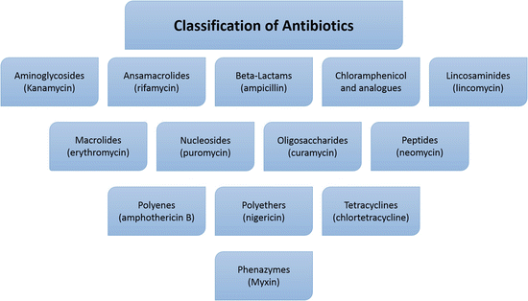

Slide 19


